Slide 1

SmartCraft AI
“Work smart,learn fast”

Slide 2
Main motive of website
“The main motive of this website will be reducing burden of student from the big and complicated topics”
For example: In textbooks there will be 300 or 400 pg books are there due this student will confuse and the main topics will not covered.
But in our websites we provide main and important topics to student and key points of chapters

Slide 3
What different provide by our website
“IN OUR WEBSITES MAINLY YOU CAN’T WANT TO ADD OR WRITE PROMPT FOR NOTES THERE WILL BE PROMPT FREE WEBSITE”. IN CHATGPT YOU WANT ADD PROMPT FOR NOTES OR TOPICS.
“IN OUR WEBSITES WE PROVIDE COURSE RELATED TOPICS AND PYQ QUESTIONS”. BECAUSE IN CHATGPT PROVIDE GENERAL KNOWLEDGE ANSWER NOT GIVING PROPER.
“WE GIVE HUGE FEARTURE IN OUR WEBSITE “REMAINDER FEATURE” REMAINDER FUNCTION MEANS WEBSITE WILL REMIND YOU FOR STUDY ,BUT CHATGPT CAN’T PROVIDE THIS FEATURE.
Exam Factor | Generic AI (ChatGPT / Gemini) | ExamCraft AI (PIE CODERS)
Prompt Fatigue | Requires typing long prompts every session to get concise bullet notes. | Zero Prompting: Dedicated single-click buttons for summaries and predicted questions.

Slide 4
WHAT FEAUTERS PROVIDE OUR WEBSITE
IMP NOTES
REMAINDER
MCQ ARENA
SUMMRIAZER
MODULES
QUESTION BANK
AI TUTOR

Slide 5
IMP NOTES
“IN IMP NOTES WE PROVIDE MOST IMPORTANT QUESTION AND THOSE TOPICS WHICH HIGHLY CHANCE IN EXAM”
“THE LENGTH OF NOTES IS VERY BRIEF AND EASY LANGUAGE ,AND THE WHOLE TOPICS WILL BE COVERD IN IMP NOTES”
“DUE TO THIS THE STUDENT BURDEN WILL BE LESS AND ALL STUDENTS GET GOOD GRADE IN EXAM “

Slide 6

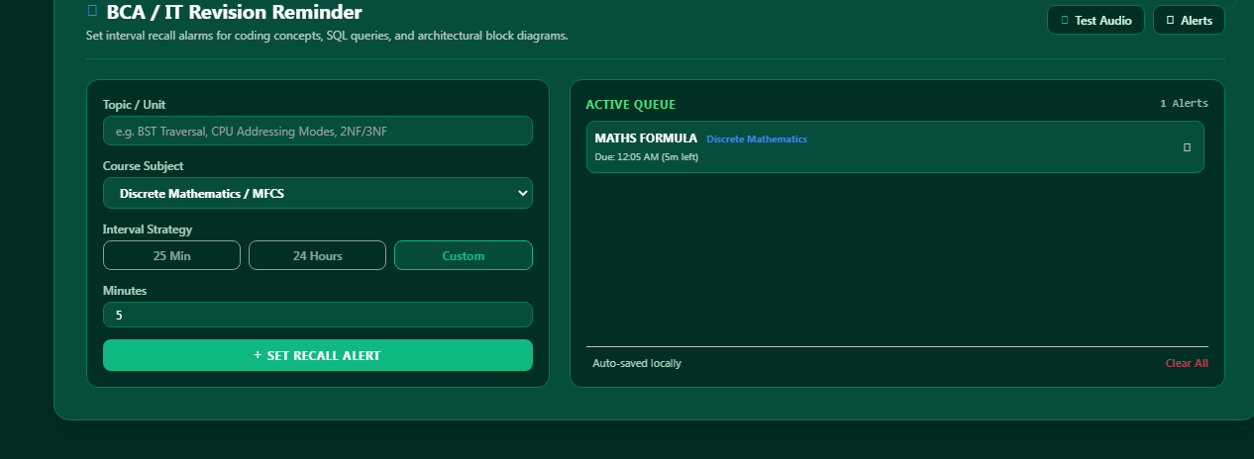
REMAINDER
IN THIS FEATURE WE PROVIDE A REMAINDER FOR STUDY LIKE TIMER OR ALARMS FEATURE TYPE DUE THIS STUDENTS REMINDS THEIR TOPICS AND CAN’T DISTRACT FROM OTHER THINGS
FOR EXAMPLE

Slide 7
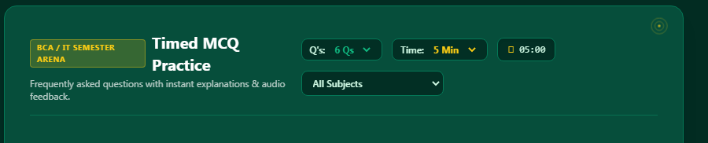

MCQ ARENA
“IN THIS FEATURE WILL MCQ EXAMS OF TOPICS WE LEARNED IN PAST
DUE TO THIS STUDENT CLEARED TOPICS AND GET TENSION
THE MAIN MOTIVE OF MCQ TEST WE CHECK STUDENT GETTING CLEARED THE CONCEPT OR NOT
THIS FEATURE WILL BE UNIQUE FROM CHATGPT AND GEMNI

Slide 8
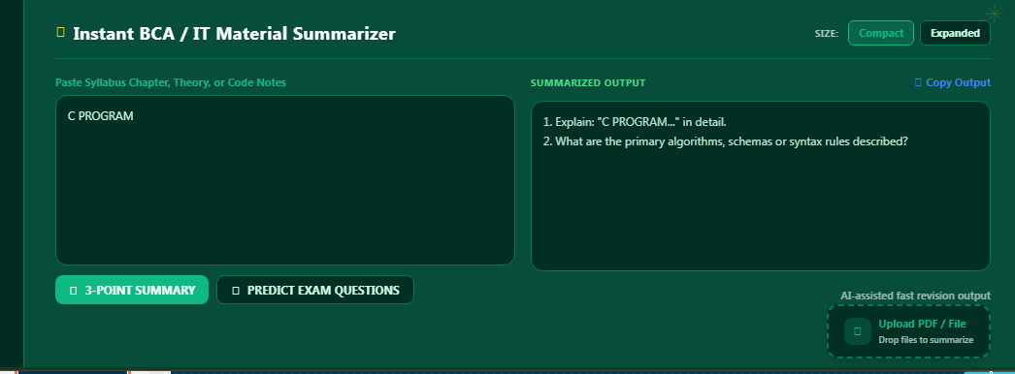

SUMMARIZER
.SUMMARIZER: IN WHICH YOU WILL GIVE TOPIC AND WEBSITE WILL GIVE TOPIC RELATED QUESTION THOSE ARE COMING IN EXAMS
AND YOU CAN ALSO INSERT PDF

Slide 9
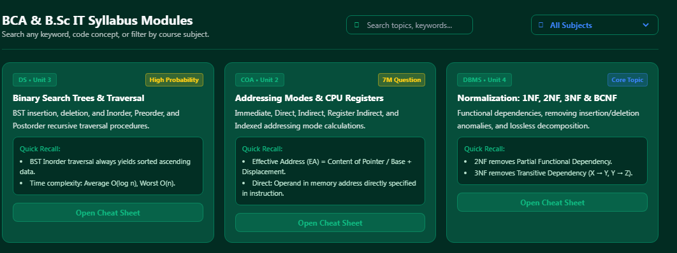
MODULES
IN MODELS WE PROVIDE IMPORTANT AND MAIN TOPICS OF TEXTBOOK DUE TO THIS THE STUDENT WORK WILL BE EASY
WE PROVIDE QUICK RECALL POINTS DUE TO THIS FEATURE STUDENT WILL EASLIY REMIND THE MAIN TOPICS AT THE LAST TIME OF EXAM

Slide 10
QUESTION BANK AND AI TUTOR
QUESTION BANK:IN THIS FEAUTURE WE PROVIDE PAST SOME YEAR QUESTION THOSE GURANTED ASK IN EXAM
AI TUTOR: IN THIS FEATURE WE PROVIDE AI TUTOR WHICH HELPS THE STUDENT TO LEARN A TOPICS EASLIY

Slide 11
THANKYOU

Slide 12
MADE BY
PIE CODERS

